Slide 1
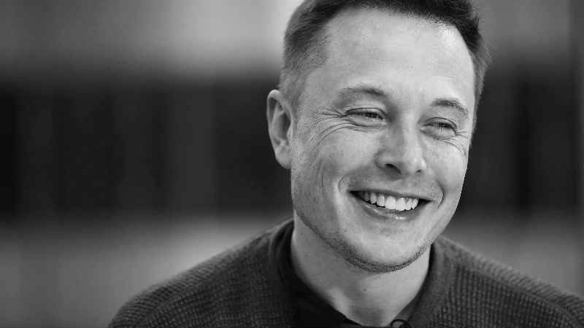
ELON MUSK
Aswin
Anji Jose
Aparna j menon

Slide 2
WHO IS ELON MUSK?

Slide 3
Elon Musk
Visionary genius who changed multiple industries. He is the CEO, Founder, Or Adviser for some of the world’s most hyped companies that are making impact on a global scale.
Co-founder of Zip2
Founder of X.com (now Paypal )
Founder ,CEO , Lead Designer of SpaceX
CEO , Product Architect of Tesla . Inc
Co-founder of Open AI
Founder of The Boring Company
Future of life institute , Neuralink , Solarcity , Starlink , Hyperloop

Slide 4
BACKGROUND OF ENTREPRENEURSHIP USED!

Slide 5
Background
Musk was born to a Canadian mother and South African father and raised in Pretoria , South Africa. He briefly attended the University of Pretoria before moving to Canada when he was 17 to attend Queen's University . He transferred to the University of Pennsylvania two years later, where he received dual bachelor's degrees in economics and physics. He moved to California in 1995 to begin a Ph.D. in applied physics and material sciences at Stanford University , but dropped out after two days to pursue a business career.
He co-founded Zip2 , a web software company, which was acquired by Compaq for $307 million in 1999. Musk then founded X.com , an online bank. It merged with Confinity in 2000, which had launched PayPal the previous year and was subsequently bought by eBay for $1.5 billion in October 2002.
In May 2002, Musk founded SpaceX , an aerospace manufacturer and space transport services company, of which he is CEO and lead designer. He joined Tesla Motors, Inc. (now Tesla, Inc.), an electric vehicle manufacturer, in 2004, the year after it was founded, becoming its product architect that year and its CEO in 2008. In 2006, he helped create SolarCity, a solar energy services company (now a subsidiary of Tesla). In 2015, he co-founded Open AI, a non profit research company that aims to promote friendly artificial intelligence. In July 2016, he co-founded Neuralink , a neurotechnology company focused on developing brain–computer interfaces. In December 2016, Musk founded The Boring Company, an infrastructure and tunnel construction company focused on tunnels optimized for electric vehicles. In addition to his primary business pursuits, he envisioned an open-source high-speed transportation system known as the Hyperloop based on the concept of a vactrain.

Slide 6
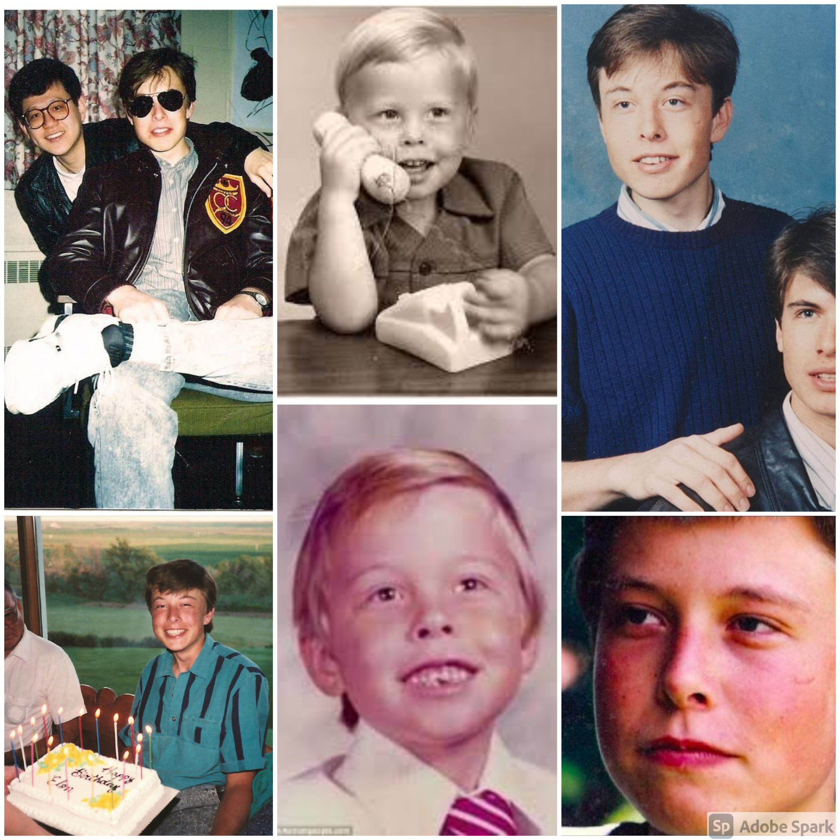

Slide 7
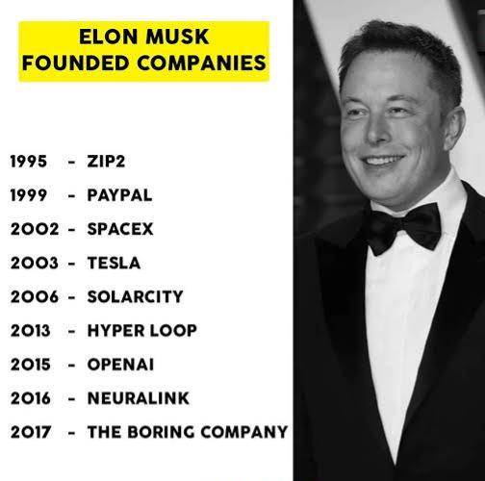
ELON MUSK’S COMPANIES

Slide 8
Entrepreneur Traits in Elon musk
INNOVATION.
Elon's companies are some of the most innovative in the world. The Tesla car was the first successful electric vehicle and the innovations with Tesla have not stopped since he launched it. Some of these are: the first electric vehicle that people actually want to drive, the best charging stations (with a different charging plug) than the rest of the industry, the best and most elegant dashboard displays, the first commercial self-driving cars, etc. The list goes on and on. Likewise, SpaceX has proven that privately launched rockets and spaceships can be a reality and SolarCity has been very successful (although not financially) in proving that solar energy is here to stay.
Elon has shown that his continuous drive to innovate is similar to Steve's and that the much-talked-about "distorted reality field" that Steve operated under is alive and well. Where other people see insurmountable obstacles, Elon sees "a minor problem that we need to address." This type of aggressive, can-do attitude is needed by entrepreneurs who continually face issues no one has encountered before. Elon has it.

Slide 9
STRATEGIC VISION AND SYNERGY.
Elon has mentioned that he sees his three companies as a unit. What he means is that transportation. whether on the ground or through the air, is a crucial industry and will continue to be in the future. By creating Tesla and SpaceX, he has covered all the bases. Eventually, the technologies used by both companies will merge and he will be able to leverage these technologies to drive costs down and create better cars and spaceships.
The one common denominator for both aerial and terrestrial transportation modes is energy. Since the oil reserves are dwindling, the next and most advanced energy type is solar. Thus, Elon sees all of these products (electric vehicles, rockets, and solar energy) as components of a complete ecosystem. It also helps that each of them can stand on their own, so even if he fails in one, he will still have the others. However, if he can bring all of these together and allow each to create synergy with the others, he will transform his companies into the largest in the world and continue to grow as a business tit

Slide 10
TYPE OF ENTREPRENEURSHIP USED

Slide 11
Types of Entrepreneurship used by Elon Musk
Entrepreneurs turn bold ideas into reality. They create jobs and contribute to the economy but there are different types of entrepreneurs and each type tends to choose their own path based on their personality, abilities and surroundings .The types of entrepreneurs vary depending on background, country and even sector but the 5 most common types are:
Innovators
Hustlers
Imitators
Researchers
Buyers

Slide 12
Innovative Entrepreneurship
InnovatIve Entrepreneurship
Innovators are the types of entrepreneurs who come up with completely new ideas and turn them into viable businesses .In most cases, these entrepreneurs change the way people think about and do things. Such entrepreneurs tend to be extremely passionate and obsessive, deriving their motivation from the unique nature of their business idea. Innovative entrepreneurs also find new ways to market their products by choosing product differentiation strategies that make their company stand out from the crowd. And sometimes it is not just standing out from the crowd but actually creating a new crowd .To say that innovators like Steve Jobs, Larry Page of Google and Microsoft founder Bill Gates were obsessed with their business would be an understatement.
Advantages of Being An Innovate Entrepreneur:
Get all the glory for the success of the business (and take all the arrows)
Create the rules
Face minimal competition during the initial days
Disadvantages of Being An Innovate Entrepreneur:
You will need a lot of capital to bring a new idea to life
Often face resistance from shareholders
The timeframe for success is longer
The ability of an innovative entrepreneur to envision a new way of thinking makes them stand out from the crowd and wildly successful in many cases however it takes significant capital, patience and commitment to bring true innovation to life

Slide 13
NATURE OF OPPORTUNITY THAT HIS ORGANISATION HAS EXPLOITED

Slide 14
Elon Musks formula for successfully growing companies faster
Musk, the most influential entrepreneur today.
Musk is the most influential entrepreneur of our generation. His approach has inspired many others to try new things and to make a real difference in the world.
Musk companies have a major theme, vision and technology.
These companies all have one major theme in common; they are set on pushing boundaries. In fact, this innovative concept has practically become synonymous with Musk’s name.
Musk is committed to challenging convention.
One of the traits that makes Elon Musk so influential is his keen eye for understanding human truth. In essence, human truth encapsulates the deeper meaning behind universally-accepted status quos. In other words, it is the common thoughts and feelings that unite us all.

Slide 15
Musk’s formula for innovation starts by identifying the what and the why of certain pain points in day-to-day life. One of his more recent ideas, from SpaceX towers, aims to change the very perception of air travel.
Musk understand everyone involved is a vector.
Recently, Dharmesh Shah, founder of HubSpot, got the opportunity to meet and converse with Musk at a dinner for legendary founders at Sequoia Capital. Like so many others, Shah wanted to know what Musk does to create a successful company. Shah asked him: “What’s your advice to build a great company that grows every day?”
‘misalignment with the customers’ needs is all but inevitable. Maintaining common goals within a company gets more and more complicated throughout growth; even more so when third-parties are introduced to the mix.
Musk is a physics man, and his response reflected this fact perfectly. He told Shah to think of it in simple terms of getting a company from point A to point B. Each person within an operation is a vector that exerts energy to achieve this goal. Everyone has a quantity of both magnitude and direction.
Firmly align team goals with customer needs.
One of the biggest problems that plague many companies is a misalignment with internal team goals. When this is the case

Slide 16
SOURCE OF IDEA

Slide 17
Source of idea:
Zip2 Corporation
Musk launched his first company, Zip2 Corporation, in 1995 with his brother, Kimbal Musk. An online city guide, Zip2 was soon providing content for the new websites of both The New York Times and the Chicago Tribune. In 1999, a division of Compaq Computer Corporation bought Zip2 for $307 million in cash and $34 million in stock options.
PayPal
In 1999, Elon and Kimbal Musk used the money from their sale of Zip2 to found X.com, an online financial services/payments company. An X.com acquisition the following year led to the creation of PayPal as it is known today.
In October 2002, Musk earned his first billion when PayPal was acquired by eBay for $1.5 billion in stock. Before the sale, Musk owned 11 percent of PayPal stock.

Slide 18
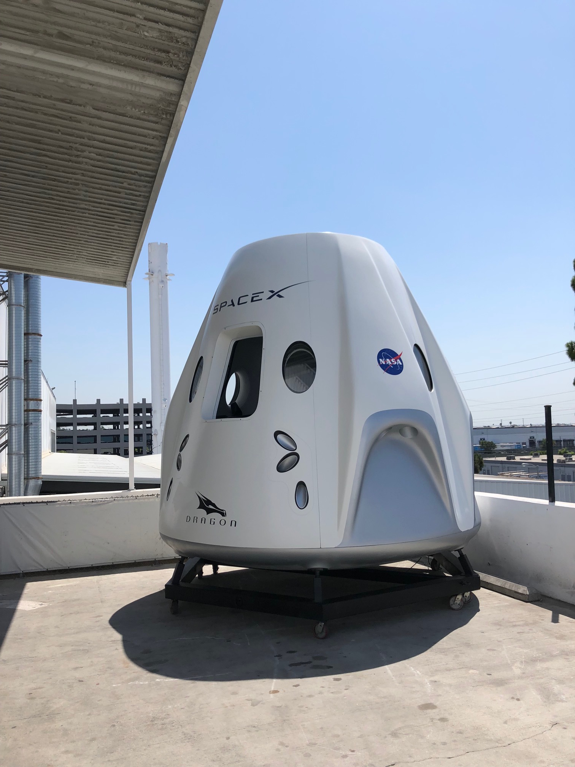
Space x
Musk founded his third company, Space Exploration Technologies Corporation, or SpaceX, in 2002 with the intention of building spacecraft for commercial space travel. By 2008, SpaceX was well established, and NASA awarded the company the contract to handle cargo transport for the International Space Station—with plans for astronaut transport in the future—in a move to replace NASA’s own space shuttle missions.

Slide 19
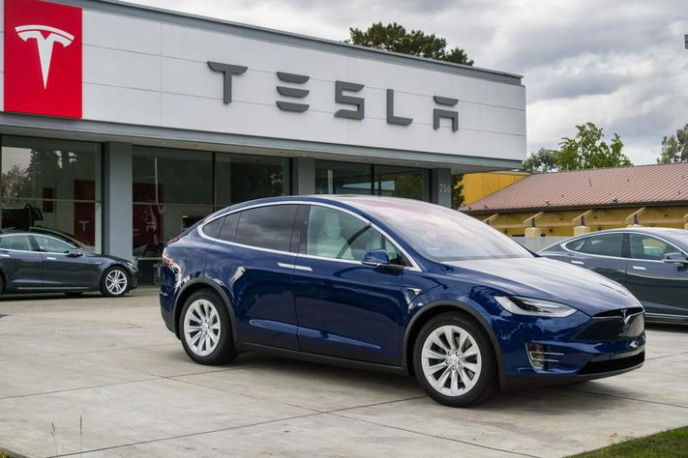
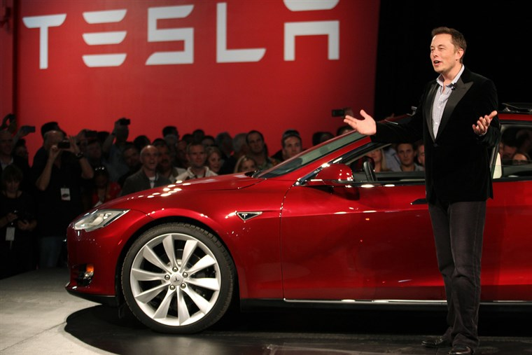
Tesla Motors
Musk is the co-founder, CEO and product architect at Tesla Motors , a company formed in 2003 that is dedicated to producing affordable, mass-market electric cars as well as battery products and solar roofs. Musk oversees all product development, engineering and design of the company's products.

Slide 20
Hyperloop
in august 2003,elon musk revealed a concept he had idealized for some time.his project was about high speed transportation system that would use pressurized capsules travelling inside tubes with reduced pressure powered by air compressors,similar to the old post office sorting system
Solar city
Solarcity was founded in 2006 by brothers peter and lyndon rive,based on a suggestion for a solar company cocept by their cousin,elon musk,who was the chairman and helped start the company in march 2016,spacex bought $90 million of solarcity stock.the idea was simple:installing solar panels would decrease the effects of global warming,a concept stressed deeply by musk.
Open AI
Open AI is a research company created by elon musk in 2015 specialized in the development of artificial intelligence.there is a great concern of musk about AI because he thinks that it would become a very poweful tool that humans would probably not be able to counteract unless specific rules set in the programming of the system.

Slide 21
RESOURCES USED TO START AND GROW THE BUSINESS

Slide 22
8 Industries being disrupted by elon musk and his companies
Automotive​
Aerospace ​
Telecommunications ​
Energy​
Transportation​
Infrastructure/Tunneling​
AI​
Healthcare

Slide 23
Challenges faced by Elon musk

Slide 24
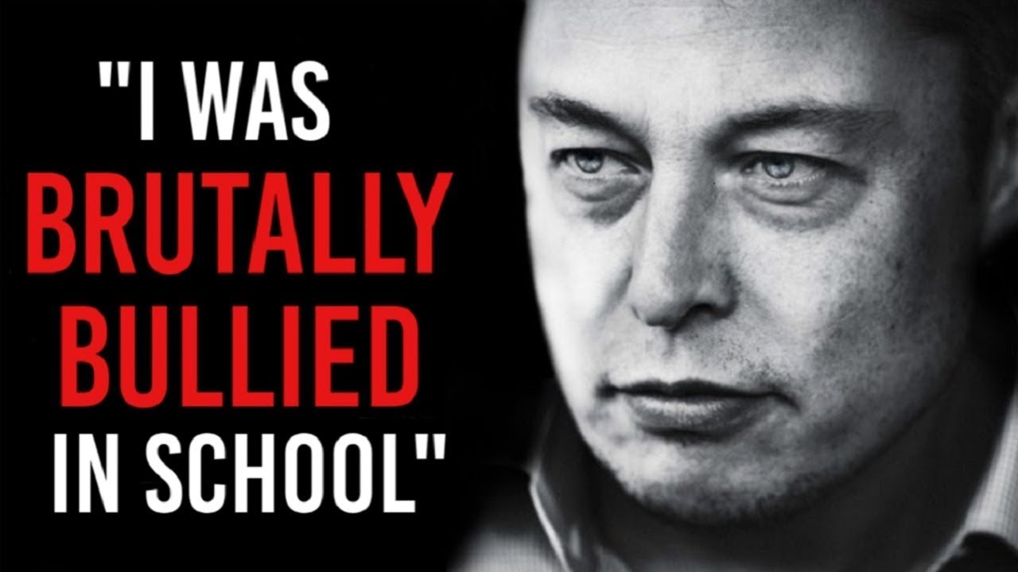
Elon Musk : No I don’t give up; I’d have to be dead or completely incapacitated!!!

Slide 25
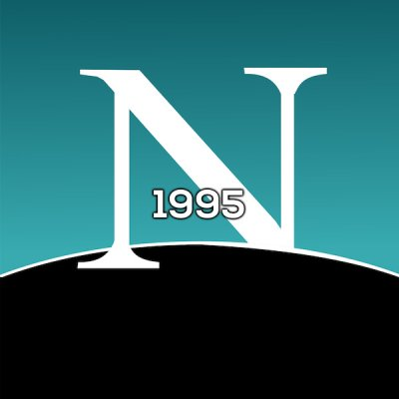
1995: Unsuccessfully applied for a job at Netscape.
Elon Musk hung out in the Netscape lobby in the ’90s hoping to get a job, but was too afraid to talk to anyone..

Slide 26
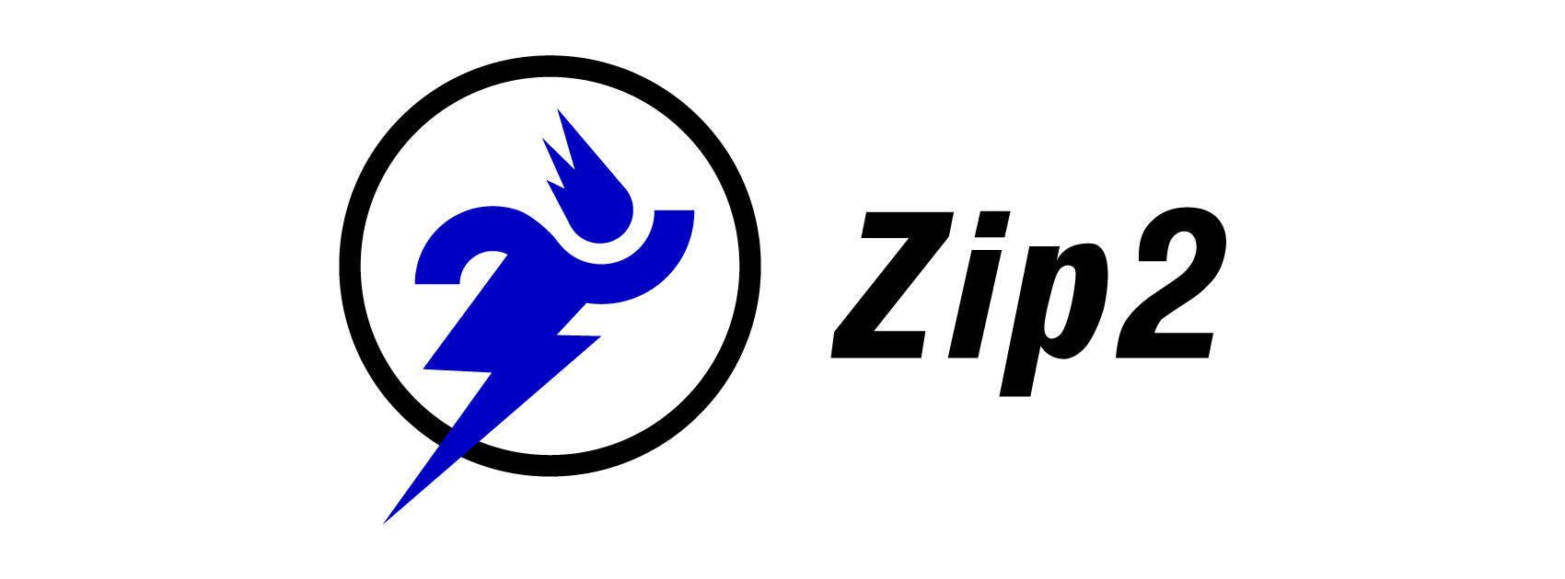

1996: Ousted as CEO of his own company, ZIP2.
Launched zip2 in 1995 with his brother. Board of Directors opposed that Elon is not fit for the CEO, and therefore sold the company to compaq.

Slide 27
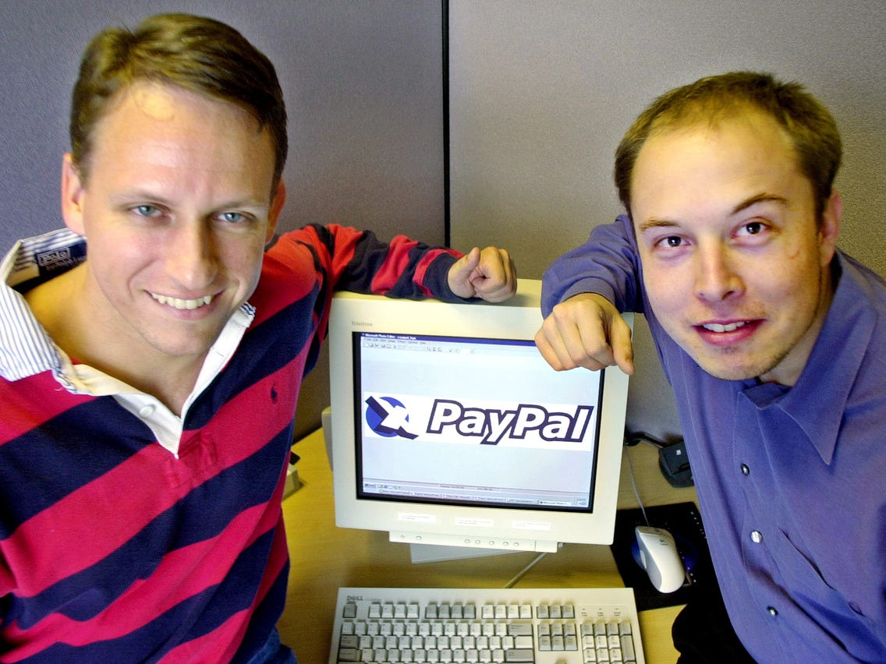
1999: First PayPal product voted one of the worst business ideas.
2000: Ousted from PayPal during his honeymoon.
While en route to Australia for a holiday, he was ousted and replaced by Peter Thiel. The betrayal made him more determined than ever to start SpaceX and Tesla, he said later.

Slide 28
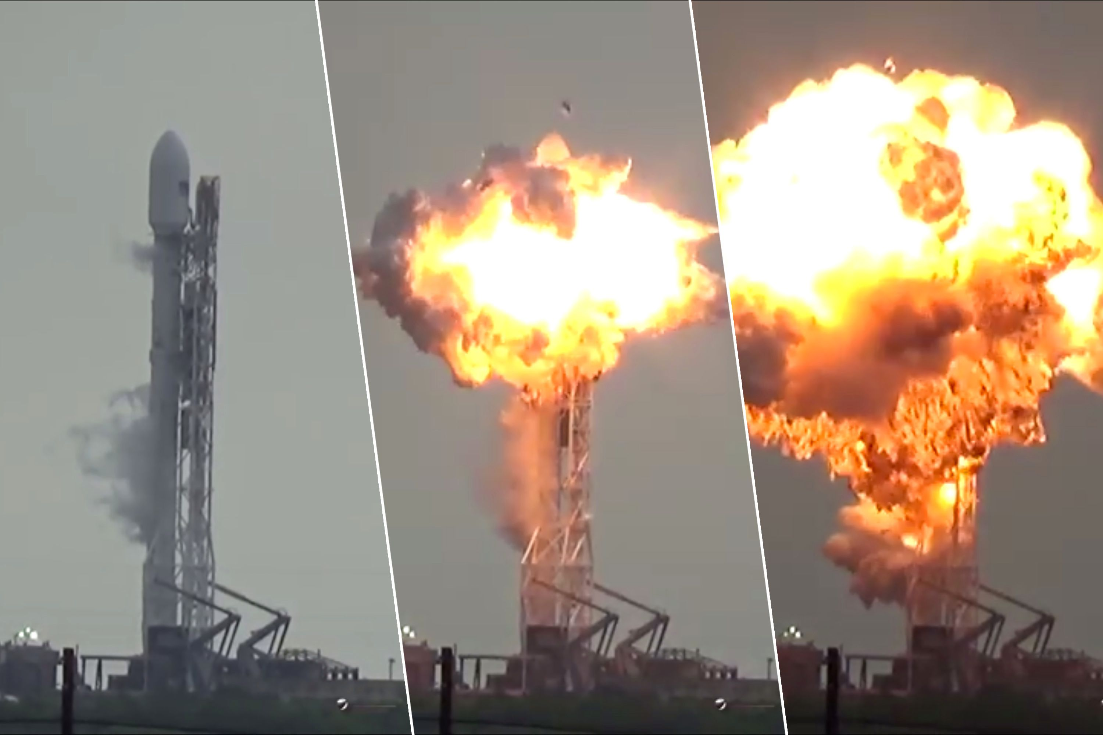
2002: Russians turned him down again in founding of SpaceX.
2006: First SpaceX rocket launch -- and his first explosion.
2007: Second rocket launch and second explosion.
2008: Third rocket launch and third failure; this time with NASA satellites onboard.
Space-x had money for all 3 launches, they failed all the 3 times!

Slide 29
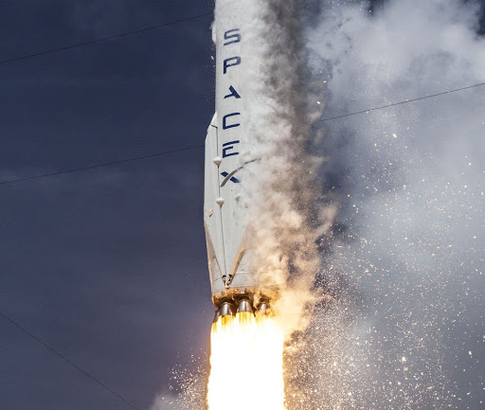
2015: Fourth rocket explosion at launch.
In 2015 FALCON9 exploded. A nd costed 260 million dollars. After 18 successful launches this was the first one to fail.

Slide 30
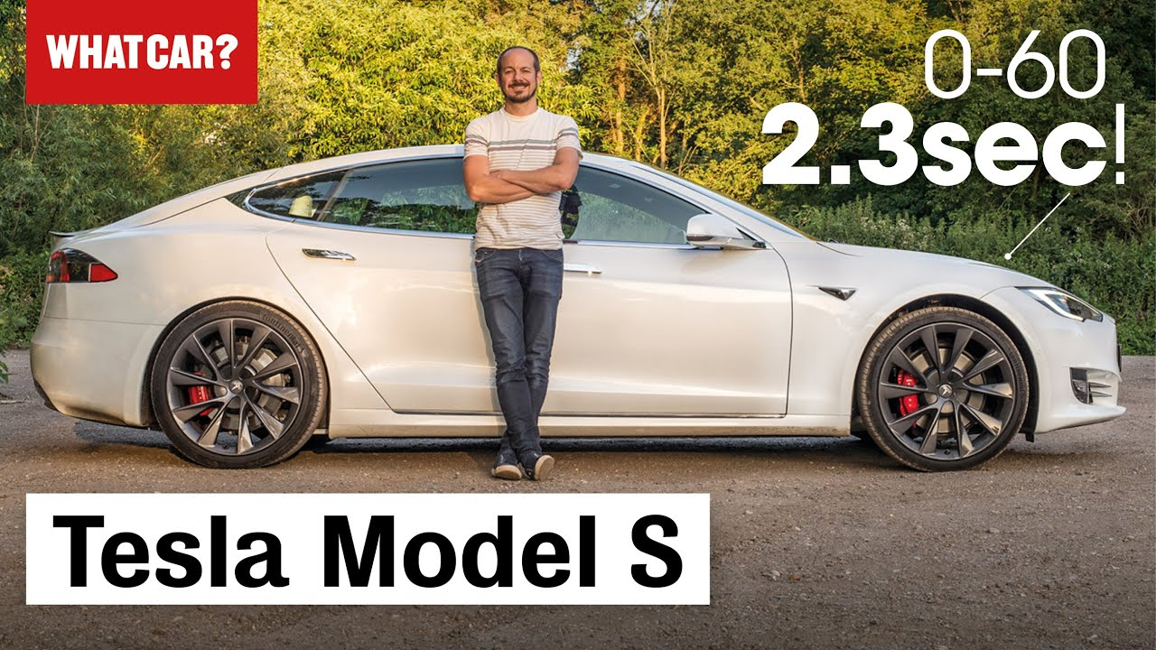
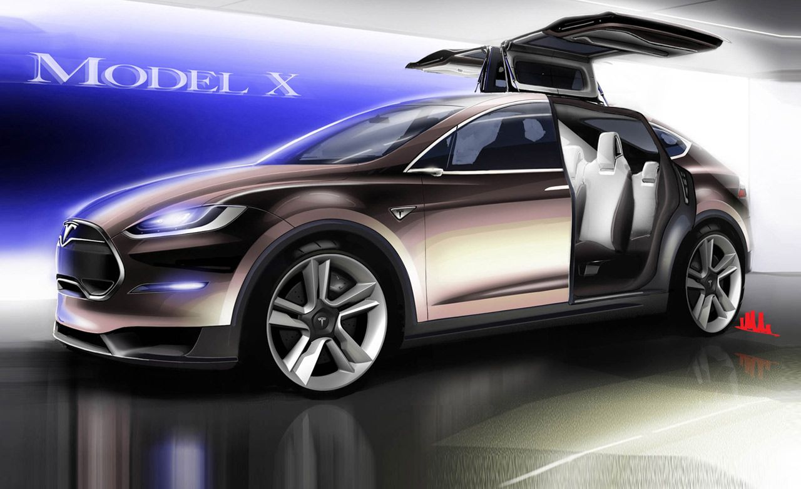
2008: Tesla and SpaceX on the brink of bankruptcy.
2014: Tesla Model S had more than one case of spontaneous battery explosion.
2016: Tesla Model X production delayed by 18 months.
2016: Fifth rocket explosion

Slide 31
BUSINESS STRATEGY USED BY ELON MUSK!

Slide 32
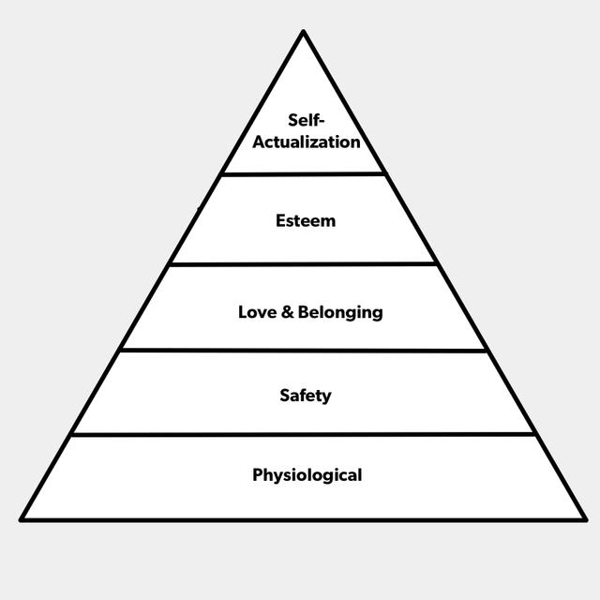
Recursive product strategy
Recursive product strategy means to work back from an end goal -5,10 or 50 years ahead - until you can hit inflection points that propel your company and its customers to the next stage, while ushering both toward the end goal. A recursive product strategy involves backing into the first step needed to build a long-term company. ... The offer of recursive product strategy is a way to build a company for the long-term.

Slide 33
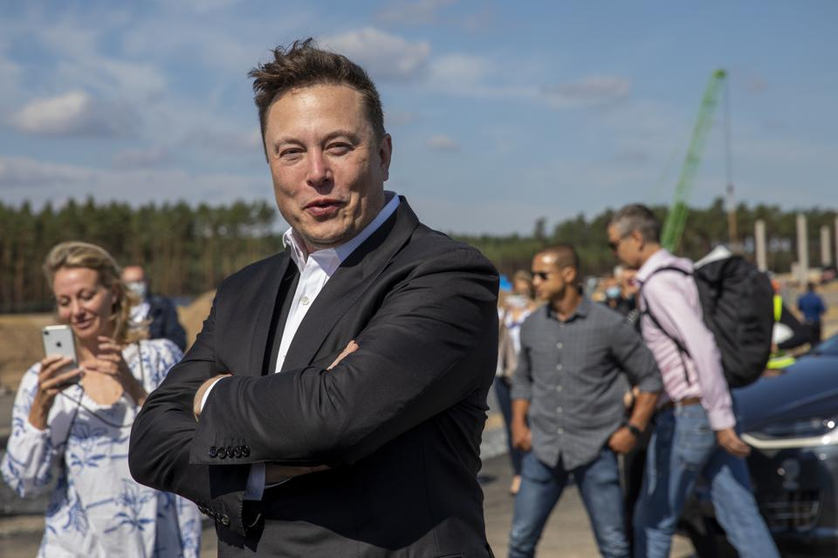
Elon Musk Is Now The Richest Person In The World, Officially Surpassing Jeff Bezos.
Musk became the world's richest man with a personal net worth of more than $188.5 billion, Bloomberg News reported. He surpassed Amazon's Jeff Bezos (by a margin of $1.5 billion) after Tesla's share saw massive gains at Thursday's (January 8) closing bell.
https://youtu.be/OGhtJyoVlYk

Slide 34
Conclusion
The story of Elon Musk is a different one , he is built like a machine and he will take head on any challenge even if the odds are high . You cannot be born with this quality or you cannot be taught , it has to be experienced every single item. The bigger the problems you solve in life , the better your life will be.

Slide 35
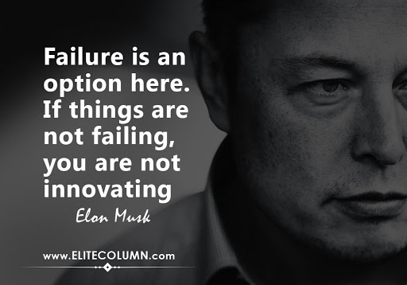

Slide 36
Thankyou!

